Slide 1
DEEP LEarNiNg MastEr Class
Day-6

Slide 2
01
Gradient Descent
Concept

Slide 3
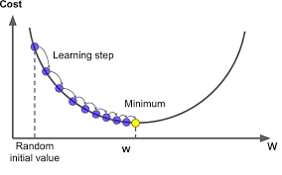
Gradient Descent
Consider Equation 2x^2
Random initialization of x
Learning_rate To determine the step size
Gradient = dy/dx = d/dx(2x^2)
= 4x
repeat until convergence
{
w = w - (learning_rate * (dJ/dw))
b = b - (learning_rate * (dJ/db))
}
If the learning rate is too large, gradient descent will miss the local minimum and fluctuate at different points uncontrollably
If the learning rate is too small, the algorithm will take too long to reach the minimum and eat up your computer’s power.

Slide 4
Batch Gradient Descent
Processes all the training examples for each iteration of gradient descent
But if the number of training examples is large, then batch gradient descent is computationally very expensive

Slide 5
Stochastic Gradient Descent
Processes 1 training example per iteration
Hence, the parameters are being updated even after one iteration in which only a single example has been processed
Number of iterations will be quite large
One approach to the problem of stochastic gradient descent not being able to settle at a minimum is to use something known as a learning schedule, seek to adjust the learning rate during training by reducing the learning rate according to a pre-defined schedule
this gradually reduces the learning rate
If the learning rate is reduced too quickly, then the algorithm may get stuck at local minima
If the learning rate is reduced too slowly, you may jump around the minimum for a long time and still not get optimal parameter

Slide 6
Mini Batch Gradient Descent
Instead of calculating the gradient on the whole dataset, or random examples of the dataset, it calculates them on small subsets of the dataset, commonly referred to as mini-batches
Works faster than both batch gradient descent and stochastic gradient descent
it works for larger training examples and that too with lesser number of iterations.

Slide 7
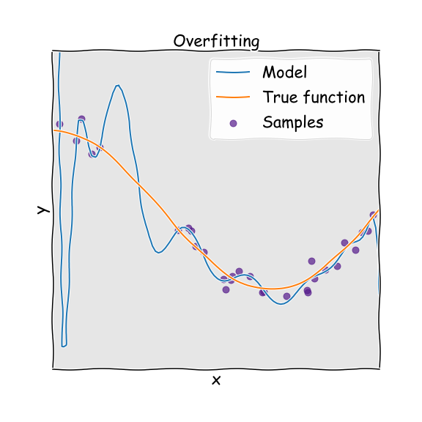
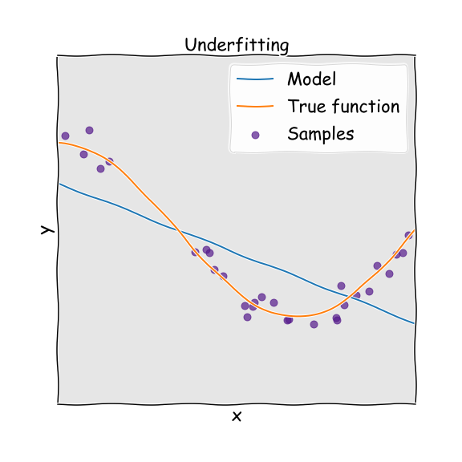
Deep Learning Terminology - 1
Good performance on the training data, poor generalization to other data.
Overfitting
Underfitting
Poor performance on the training data and poor generalization to other data

Slide 8
Deep Learning Terminology - 2
Epochs
Single training iteration of all batches in both forward and back propagation
1 epoch is a single forward and backward pass of the entire input data

Slide 9
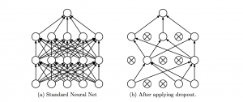
Deep Learning Terminology - 3
Dropout
Dropout is a regularization technique which prevents over-fitting of the network
During training a certain number of neurons in the hidden layer is randomly dropped

Slide 10
—Asset & Liabilities
Short bytes – D6
Asset is something that puts money in your pocket
Liability is something that takes money out of your pocket

Slide 11
Thanks!
Thanks!
Follow Me on LinkedIn : Link in Description
+91 7305845758
Pantechsolutions.net
Ask Your Friends to Participate on this Event

